Slide 1
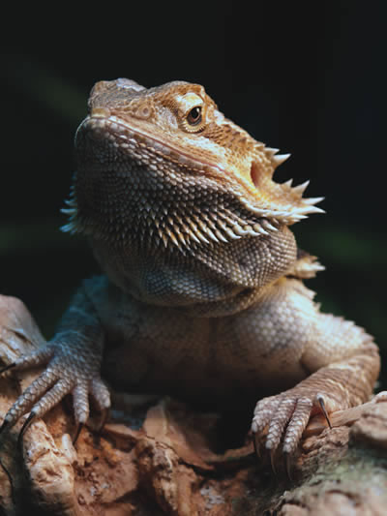
Bearded Dragon
Mrs. Chenu
4th Grade Room 23
11/20/11

Slide 2
Primary Sources of Energy
omnivores
plant matter
insects
spiders
occasional small rodent or lizard
about 20 percent of their total diet is plant matter.

Slide 3
Habitats
Found only in Australia
eastern states to the eastern half of South Australia and southeastern Northern Territory
Semi-arid to arid climates

Slide 4
Environmental Factors
Abiotic (Nonliving) | Biotic (Living)
Red Clay | Eastern Dwarf Tree Frog
Water | Eucalyptus Trees
Sun | Wombat
Hot dry climate | Dingo

Slide 5
Food Chain

Slide 6
Adaptations
Beard
Thorny Exterior
Head Bobbing
Waving
Water from prey
Climbing ability

Slide 7
References
Beardies of Australia. (2009). Retrieved November 10, 2011, from http://www.lions.com/africa/b2k
Maceo, L. (2010, February 8). Animal adaptations. All about animals. Retrieved November 12, 2011, from http://book.edu/animals

